Slide 1
CSCIU 210 Computer Organization AKM Jahangir A Majumder, PhD
Fall 2018 - Lecture 2
August 27, 2018
Note: Some slides are adapted from those used by previous instructors and some slides include figures from the textbook.

Slide 2
Review and Learning Outcomes
We described different types of computers including different parts
We will begin to cover Instruction Set Architecture (ISA), computer model and performance today
Will learn:
Computer model and Moore’s law
Computer performance
Homework #1 will post on Blabckboard soon, which will due on Wednesday, Sept 5 at the beginning of the lecture
We will have our first Quiz on Friday, Sept 7, 2018, which will be on Lectures 1, 2, 3 and 4

Slide 3
Abstractions
Abstraction helps us deal with complexity
Hide lower-level detail
Instruction set architecture (ISA)
The hardware/software interface
Application binary interface
The ISA plus system software interface
Implementation
The details underlying and interface

Slide 4
Instruction Set Architecture (ISA)
A very important abstraction
interface between hardware and low-level software
standardizes instructions, machine language bit patterns, etc.
Advantage: different implementations of the same architecture
Disadvantage: sometimes prevents using new innovations
Modern instruction set architectures:
IA-32, PowerPC, MIPS, SPARC, ARM, and others

Slide 5
MIPS Computer Simulator: SPIM
SPIM is a simulator developed for MIPS computer simulation.
You can download SPIM simulator PCSpim http://www.cs.wisc.edu/~larus/spim.html
We are going to cover how to use a SPIM simulator.

Slide 6
Hierarchy of Computer Architecture
Application (ex: browser)
Operating
Compiler
System
(Mac OS X)
Software
Assembler
Instruction Set
Architecture
Hardware
Processor
Memory
I/O system
Datapath & Control
Digital Design
Circuit Design
transistors
Coordination of many
levels (layers) of abstraction

Slide 7
The Instruction Set: a Critical Interface
software
instruction set
hardware

Slide 8
What is Computer Architecture?
Computer Architecture = Instruction Set Architecture + Machine Organization + Hardware

Slide 9
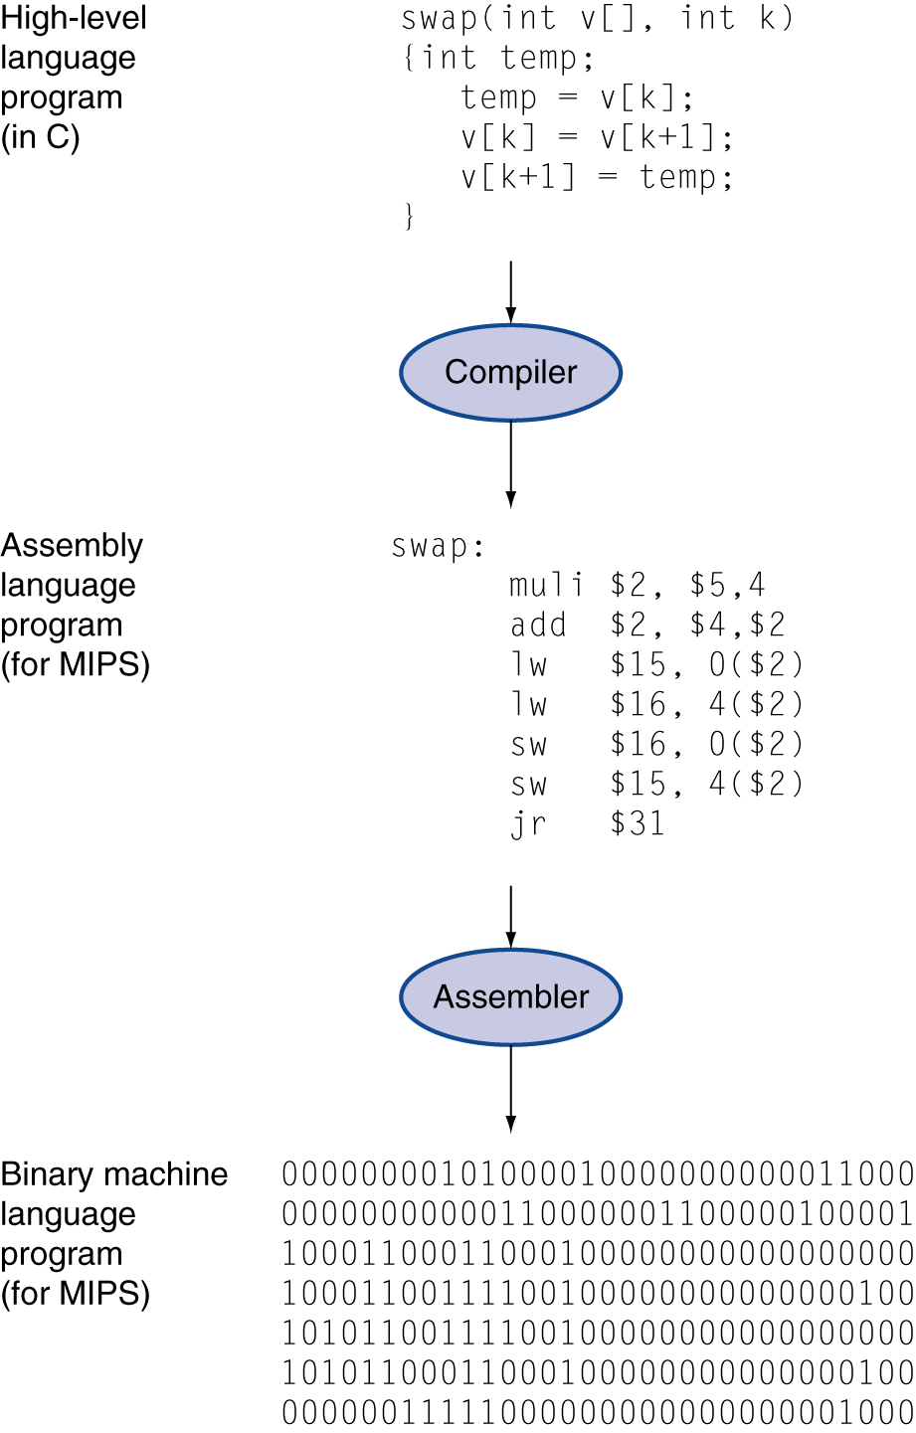
Levels of Program Code
High-level language
Level of abstraction closer to problem domain
Provides for productivity and portability
Assembly language
Textual representation of instructions
Hardware representation
Binary digits (bits)
Encoded instructions and data

Slide 10
Levels of Representation (II)
Compiler
Assembler
00a51020
00421020
00821020
8c620000
8cf20004
acf20000
ac620004
03e0008
temp=v[i]
v[i]=v[i+1]
v[i+1]=temp
add $2, $5, $5
add $2, $2, $2
add $2, $4, $2
lw $15, 0($2)
lw $16, 4($2)
sw $16, 0($2)
sw $15, 4($2)
jr $31
One statement
=several
instructions
mostly
one-to-one
Which one will be more difficult to design: Complier or Assembler?

Slide 11
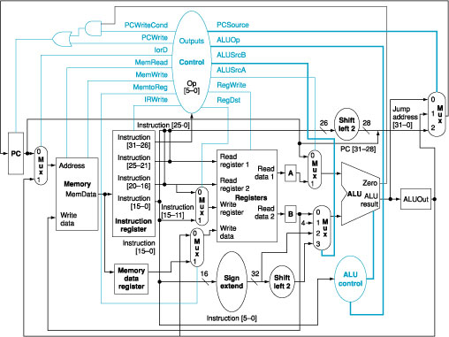
A MIPS Computer Architecture:

Slide 12
Hardware Components of any Computer
Five classic components of all computers:
1. Control Unit; 2. Datapath; 3. Memory; 4. Input; 5. Output
}
Processor
Computer
Keyboard, Mouse, etc.
Processor
(active)
Memory
(passive)
(where
programs,
data
live when
running)
Devices
Control
Unit
Input
Disk
Datapath
Output
Display, Printer, etc.

Slide 13
Inside the Processor (CPU)
Datapath: performs operations on data
Control: sequences datapath, memory, ...
Cache memory
Small fast SRAM memory for immediate access to data

Slide 14
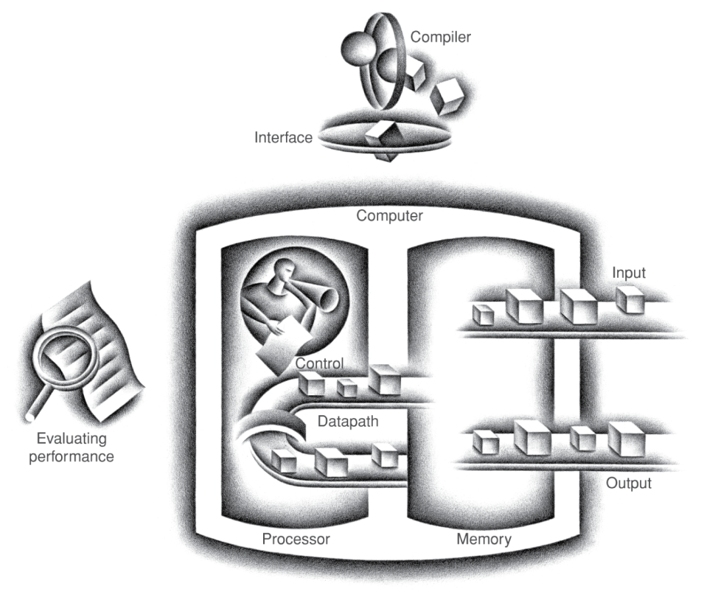
Components of a Computer
Same components for all kinds of computer
Desktop, server, embedded
Input/output includes
User-interface devices
Display, keyboard, mouse
Storage devices
Hard disk, CD/DVD, flash
Network adapters
For communicating with other computers

Slide 15
The Von-Neumann Computer Model
Partitioning of the computing engine into components:
Central Processing Unit (CPU):
Control Unit (instruction decode, sequencing of operations),
Datapath (registers, arithmetic and logic unit, buses).
Memory: Instruction (program) and operand (data) storage.
Input/Output (I/O).
-
Control
Input
Memory
(instructions,
data)
Datapath
registers
ALU, buses
Output
Computer System
CPU
I/O Devices

Slide 16
Harvard and von Neumann Architecture
CPU
Data
Memory
CPU
Memory
(Data
and Code)
Code
Memory
Harvard Architecture
Von Neumann Architecture

Slide 17
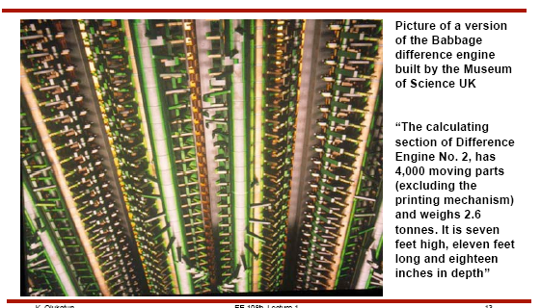
Mechanical Computer: Babbage Difference Engine (1822)

Slide 18
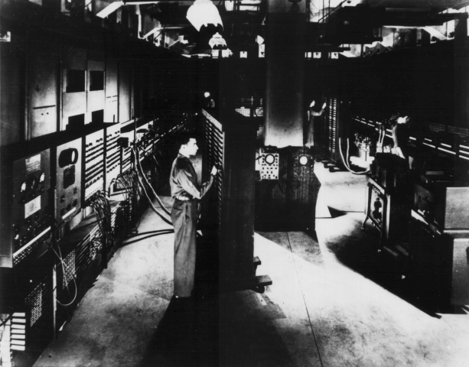
Historical Perspective
ENIAC built in World War II was the first general purpose computer
Used for computing artillery firing tables
80 feet long by 8.5 feet high and several feet wide
Each of the twenty 10 digit registers was 2 feet long
Used 18,000 vacuum tubes and Weighed 80 tons
Performed 5000 additions per second (3 GHz Pentium 4 can do about 600 millions of additions per second)

Slide 19
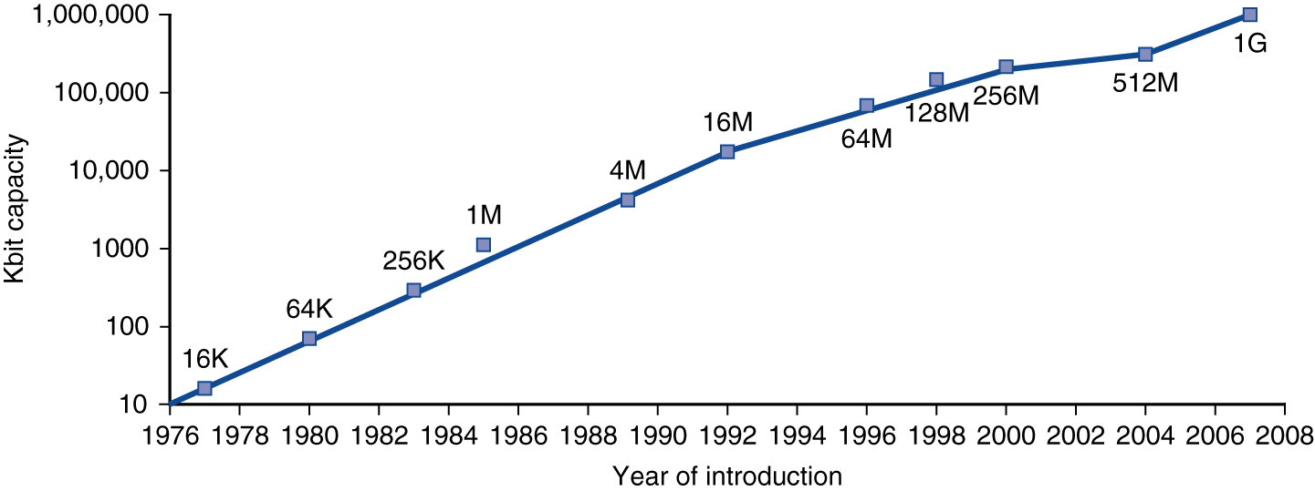
Technology Trends
Electronics technology continues to evolve
Increased capacity and performance
Reduced cost
DRAM capacity
Year | Technology | Relative performance/cost
1951 | Vacuum tube | 1
1965 | Transistor | 35
1975 | Integrated circuit (IC) | 900
1995 | Very large scale IC (VLSI) | 2,400,000
2005 | Ultra large scale IC | 6,200,000,000

Slide 20
Computer Technology – Dramatic Change!
Memory
DRAM capacity: 2x / 2 years (since ‘96); 64X size improvement in last decade.
Processor
Speed 2x / 1.5 years (since ‘85); 100X performance in last decade.
Disk
Capacity: 2x / 1 year (since ‘97) 250X size in last decade.
How long will Moore’s Law last?

Slide 21
What Can we Learn From Moore’s Law
Rapid Improvement is the key in computer industry!

Slide 22
Performance
Measure, Report, and Summarize
Make intelligent choices
See through the marketing hype
Key to understanding underlying organizational motivation
Why is some hardware better than others for different programs?
What factors of system performance are hardware related? (e.g., Do we need a new machine, or a new operating system?)
How does the machine's instruction set affect performance?

Slide 23
Understanding Performance
Algorithm
Determines number of operations executed
Programming language, compiler, architecture
Determine number of machine instructions executed per operation
Processor and memory system
Determine how fast instructions are executed
I/O system (including OS)
Determines how fast I/O operations are executed

Slide 24
Defining Performance
Which airplane has the best performance?

Slide 25
Response Time and Throughput
Response time
How long it takes to do a task
Throughput
Total work done per unit time
e.g., tasks/transactions/… per hour
How are response time and throughput affected by
Replacing the processor with a faster version?
Adding more processors?
We’ll focus on response time for now…

Slide 26
Relative Performance
Define Performance = 1/Execution Time
“X is n time faster than Y”
Example: time taken to run a program
10s on A, 15s on B
Execution Time_{B} / Execution Time_{A} = 15s / 10s = 1.5
So A is 1.5 times faster than B

Slide 27
Measuring Execution Time
Elapsed time
Total response time, including all aspects
Processing, I/O, OS overhead, idle time
Determines system performance
CPU time
Time spent for processing a given job
Discounts I/O time, other jobs’ shares
Comprises user CPU time and system CPU time
Different programs are affected differently by CPU and system performance

Slide 28
CPU Clocking
Operation of digital hardware governed by a constant-rate clock
Clock period
Clock (cycles)
Data transfer and computation
Update state
Clock period: duration of a clock cycle
e.g., 250ps = 0.25ns = 250×10^{–12}s
Clock frequency (rate): cycles per second
e.g., 4.0GHz = 4000MHz = 4.0×10⁹Hz

Slide 29
CPU Time
Performance improved by
Reducing number of clock cycles
Increasing clock rate
Hardware designer must often trade off clock rate against cycle count

